Slide 1
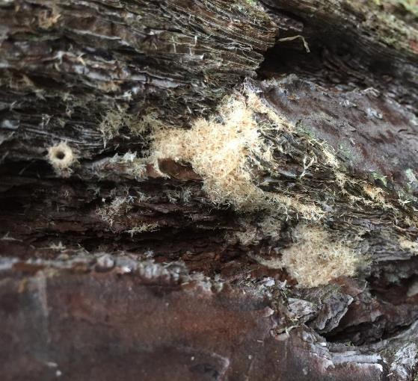
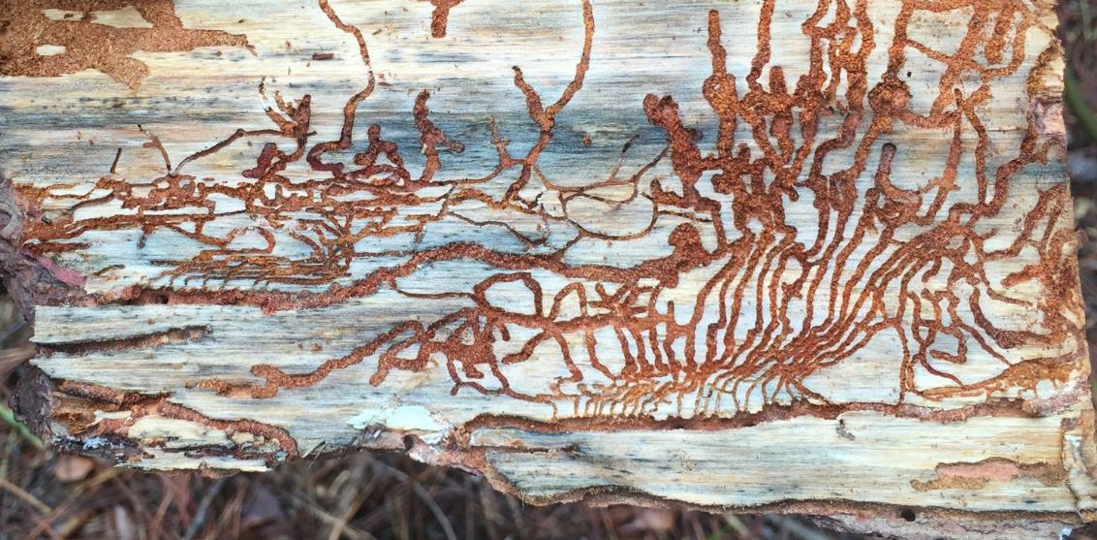
Beetle Pests of Pines in Georgia
Elizabeth Benton
Warnell School of Forestry and Natural Resources
University of Georgia
Notes:
Note: Information has been included in this presentation to fit multiple audiences, from homeowners to foresters. The presentation in its entirety may be too long for many outreach events. Select the slides that best fit your audience and timeframe.

Slide 2
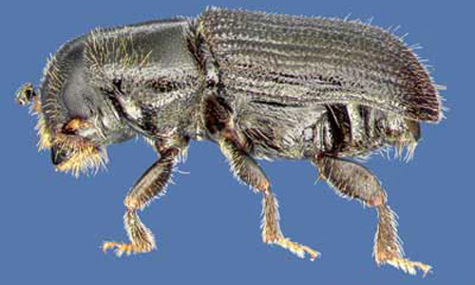
Outline
Beetles in pine
Southern pine beetles
Ips engraver beetles
Black turpentine beetles
Woodborers
Management recommendations
David T. Almquist, University of Florida
Notes:
The talk will cover multiple beetle species that are pests of pines in the south. Bark beetles – southern pine beetle, engraver beetles, and black turpentine beetles are all from the family Curculionidae – the weevil family. These beetles can be very problematic in pine trees. However, there are other beetles that are often observed feeding on pines, such as woodboring beetles. Learning about the different beetles that may be present can help you understand what is happening in rural and urban forests.
Descriptions of the different beetles will be followed by management recommendations to maintain healthy pine trees.
Note: Emphasize during the talk that most of these beetles are secondary pests. Secondary pests are not the initial pine health problem, but are taking advantage of unhealthy pine trees. However, southern pine beetle (SPB) is not a secondary pest.

Slide 3
Notes:
Forestry in Georgia generates more than $3.5 billion in wages, $19.2 billion in revenue, and employs more than 50,000 people.* Pine forests throughout the state, add both economic and scenic/recreational value. Trees in yards increase property values for both the residential lot and nearby properties.
Pine forests also improve air and water quality and provide habitat for wildlife.
While pine stands and wooded yards may be located on private property, citizens of Georgia all benefit from their presence.
*2015 Economic Benefits of the Forestry Industry in Georgia
http://www.gfc.state.ga.us/utilization/economic-impacts/2015%20Economic%20Benefits%20Report%20FINAL.pdf

Slide 4
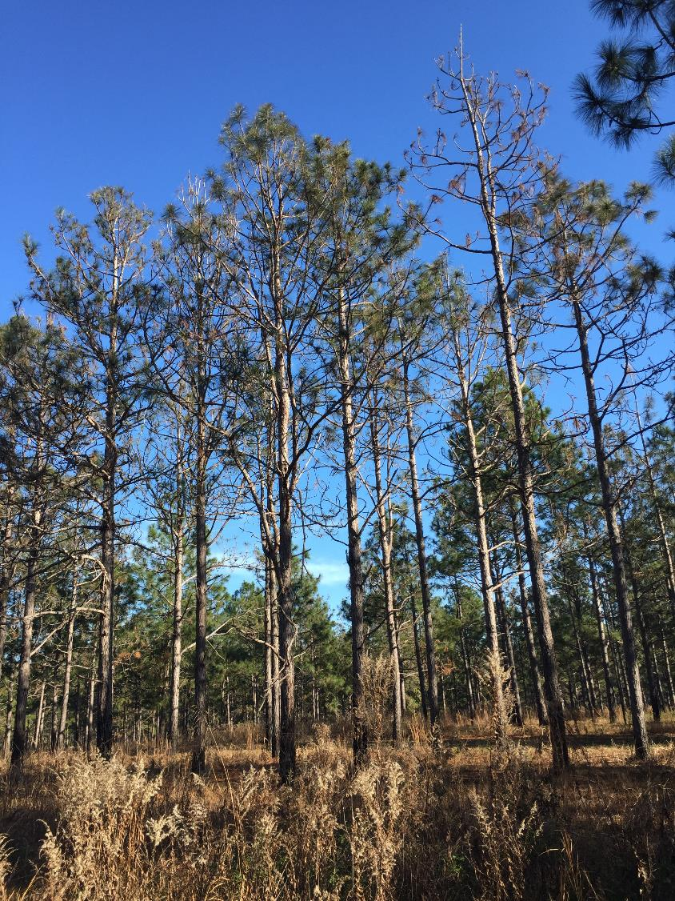
Notes:
Sometimes the pines in our forests and yards are not healthy. An initial symptom of an unhealthy tree may be a thinning canopy. Often the tree has been irreparably damaged by insects or diseases by the time symptoms are observed.
Note: Symptoms are the tree’s response to stimulus or disturbance, e.g., thinning crown, yellow and red needles. If sloughing bark is observed the tree is already dead.

Slide 5
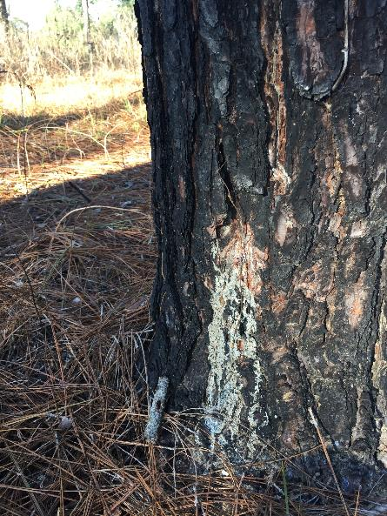
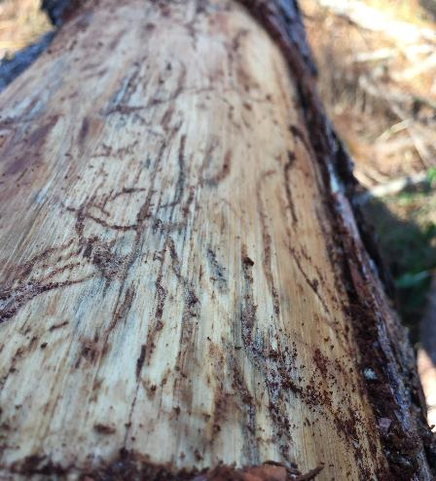
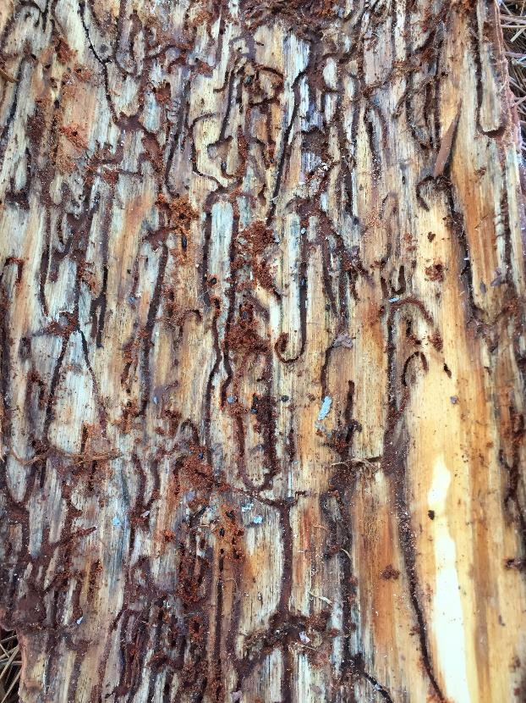
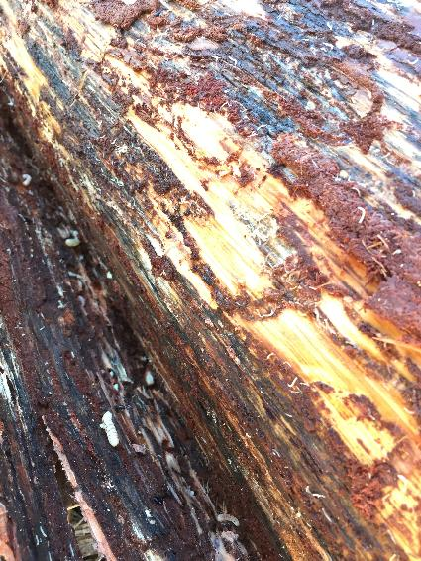
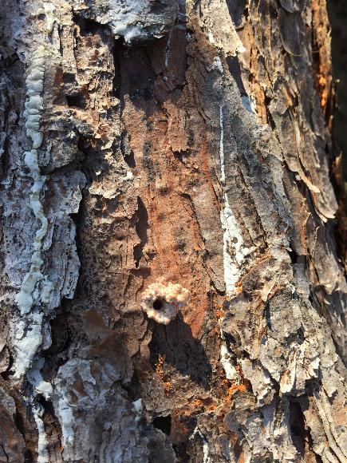
Notes:
Many different signs of insect damage may be present upon closer examination, and multiple beetle species can attack a tree at the same time. All of these different signs, such as tunnels under the bark, holes on the trunk, and pitch flowing down the bark, can make it difficult to know exactly what is causing the tree to be sick (or already dead). Some signs, like pitch flowing may not be present. Trees produced pitch to flush out beetles, but unhealthy trees may not have the resources to produce enough pitch.
Note: Signs are the physical indications of insect activity, e.g., pitch tubes, frass.

Slide 6
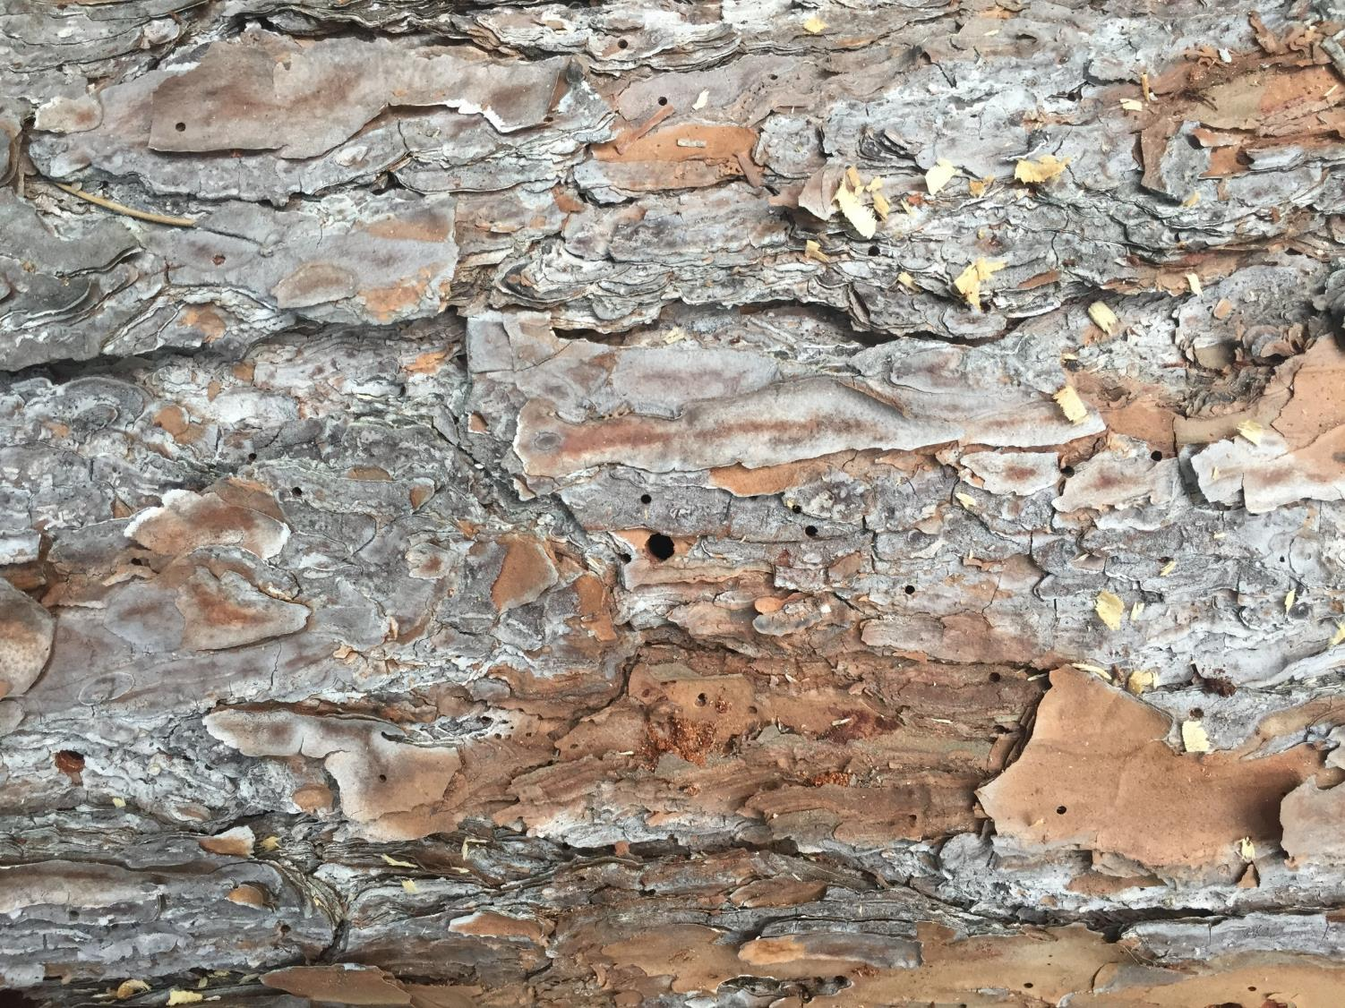
Notes:
Different size holes may be present on the outside of the trunk.

Slide 7
Primary or secondary?
Notes:
It is important to consider whether the insects making the holes are a primary or secondary problem. A primary problem is the agent that is causing the initial tree health problem. A secondary problem, in this case, is an insect that is able to feed on the tree once it is in a weakened state.
Often the primary problem is not an insect at all. Drought, flooding, root compaction, and mechanical damage can weaken trees. Once weakened, the trees are unable to defend themselves against insect pests.

Slide 8
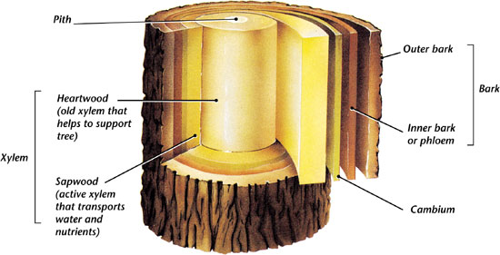
Tree Structure
Where are bark beetles in the tree?
Notes:
Before discussing pine beetles, it is important to understand where in the tree they are feeding.
Many beetles in trees are hidden pests. Although not often seen on the outside of the tree, they are causing a great amount of damage while hidden inside the tree.
Trees are built like a “two-way street” on the inside. There is vascular tissue that moves materials throughout the tree – similar to our vascular system.
Xylem is located in the inner part of the tree. The xylem moves water from the roots to the canopy. Xylem supplies the tree with water.
The cambium is a thin layer of tissue that produces new cells that become xylem, phloem, or more cambium.
Phloem or the “inner bark” is located just under the bark. The phloem transports organic compounds, like glucose and starch, made during photosynthesis. Phloem supplies the tree with “food.”
The “two-way street” on the inside of the tree moves water up through the xylem and food down through the phloem. Unfortunately, bark beetles cause a problem with movement of materials along the “street.”

Slide 9
Woodborers
Bark Beetles
Tree Structure
Where are bark beetles in the tree?
In the inner bark or phloem
Notes:
Bark beetles feed in the phloem. Adults bore tunnels, also called galleries, through the bark. Once inside the tree, adults start to dig galleries and lay eggs. Larvae hatch from the eggs and dig more galleries. They differ from woodborers because none of their life stages enter the xylem.
The phloem that is bringing energy to the trunk and roots of the tree is mechanically damaged by the beetle galleries. The tree is starved because the food cannot move down through the vascular tissue. The disruption of the vascular tissue is called “girdling.”
Southern pine beetle and engraver beetles introduce blue stain fungi to pine trees. The fungi occludes the xylem tissue, which hastens tree mortality. Blue stain fungi actually stains the wood a blue color. Trees with blue stain are less desirable for mills, which reduce the value of the timber. Black turpentine beetles do not generally transmit blue stain fungi.
Woodboring beetles are larger than bark beetles and feed in the phloem, heartwood and sapwood. However, woodborers generally do not feed on pines until they are weakened and dying.

Slide 10
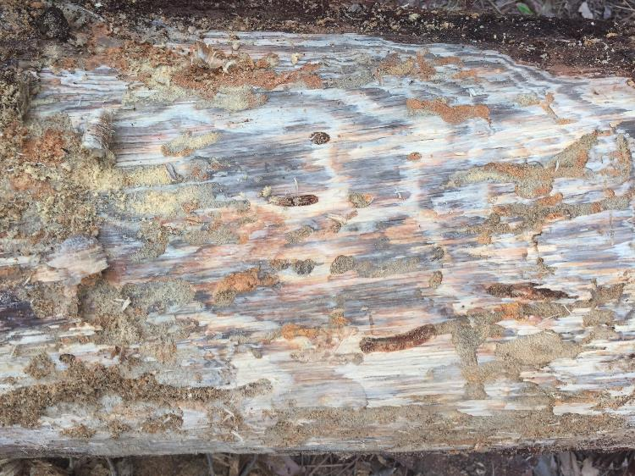
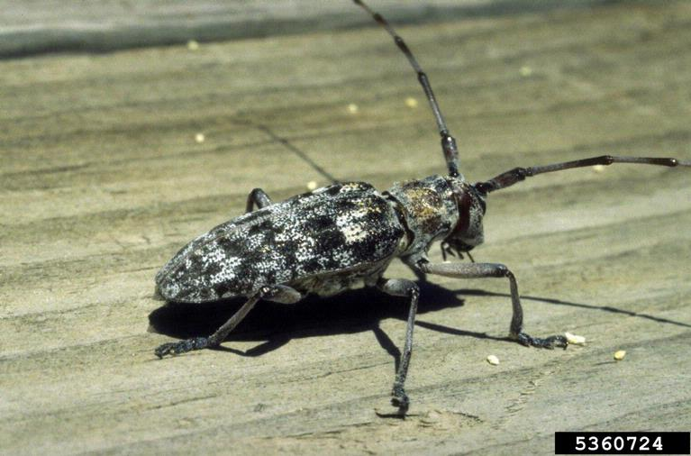
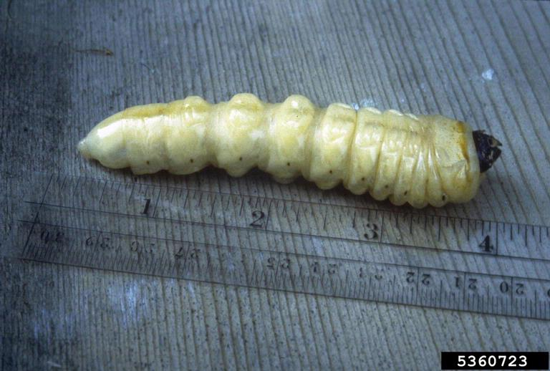
Roundheaded Wood Borers
Monochamus spp. (Cerambycidae)
Longhorned beetles - pine sawyers
1-3 yr life cycle
Tunnel into
phloem
heartwood and sapwood (xylem)
Attack weakened/dying trees
Secondary
Tunnels in the heartwood
Eugene E. Nelson, Bugwood.org
Eugene E. Nelson, Bugwood.org
Notes:
The discussion of different beetles will begin with some of the larger, more obvious woodboring beetles. Sometimes we see a really large bug, and it seems logical that something so large would be what is killing the tree. However, that is not the case with beetles that feed on pines.
Pine sawyers are a type of longhorned beetle that feeds on pine trees. These beetles are about an inch long and have a 1 – 3 year life cycle. The larvae can tunnel into the heartwood – that’s the xylem in the innermost part of the tree. Sometimes the larvae can be heard tunneling inside the tree.
Pine sawyers attack weakened, dying trees. They may still be present in trees that are already dead. Pine sawyers are a secondary pest. Control measures are not appropriate for this pest. Control measures will not preserve the tree, because the tree is already dying by the time pine sawyers begin feeding.

Slide 11
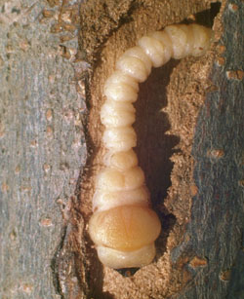
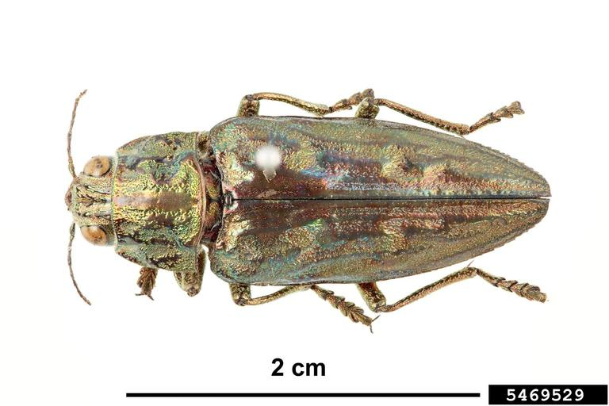
Flatheaded Wood Borers
Buprestidae
Metallic Wood Borers
1-2 yr life cycle
Tunnel into
phloem
heartwood and sapwood (xylem)
Attack weakened/dying trees
Secondary
Tunnels in the heartwood
James Solomon, USDA Forest Service, Bugwood.org
Pest and Diseases Image Library, Bugwood.org
Notes:
Fladheaded wood borers are also called metallic wood borers, because adults have a metallic or iridescent appearance. Larvae have a small head. The next body segment is broad with a flattened top and bottom, which makes the “head” appear flattened.
Flatheaded wood borers have a 1 – 2 year lifecycle, most of which is spent living under the bark of trees. They feed on weakened or dead trees, and can tunnel into both the phloem and xylem. No control measures are recommended, because the tree health is poor when flatheaded wood borers attack.

