Slide 1
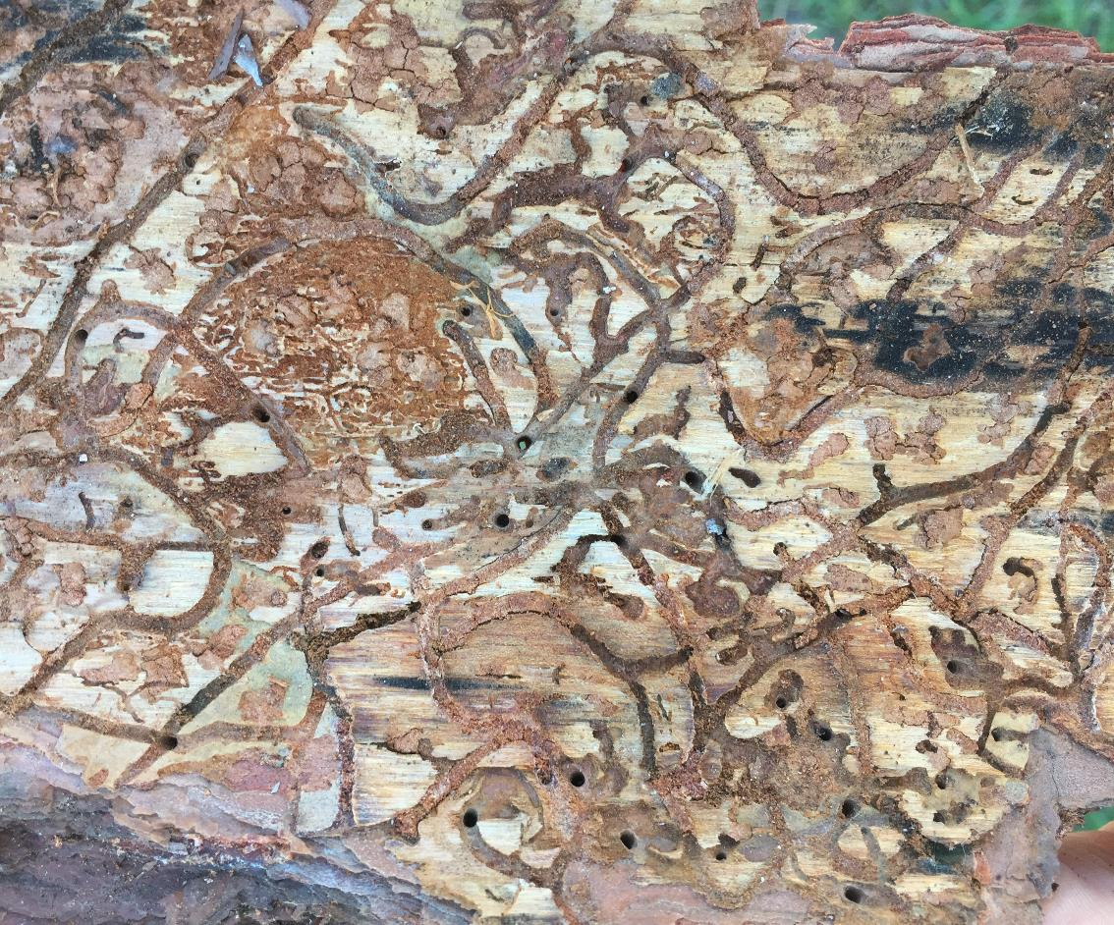
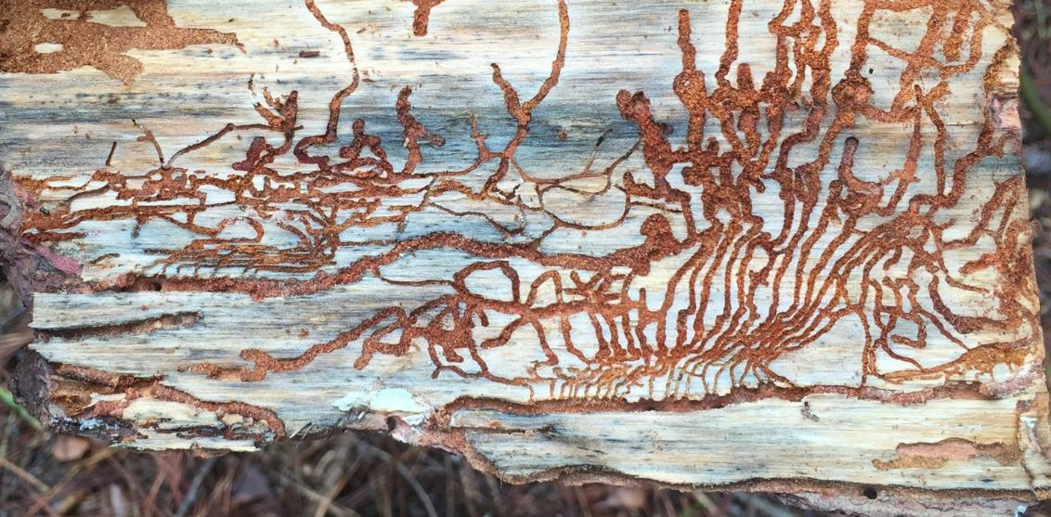
SPB
S-shaped galleries
engraver beetle
branching galleries
Notes:
Comparison of S-shaped SPB galleries to an engraver beetle galleriey. Engraver beetles tend to have H- or Y-shaped galleries. The picture to the left is a SPB gallery. The picture on the right is a six-spined Ips gallery.

Slide 2
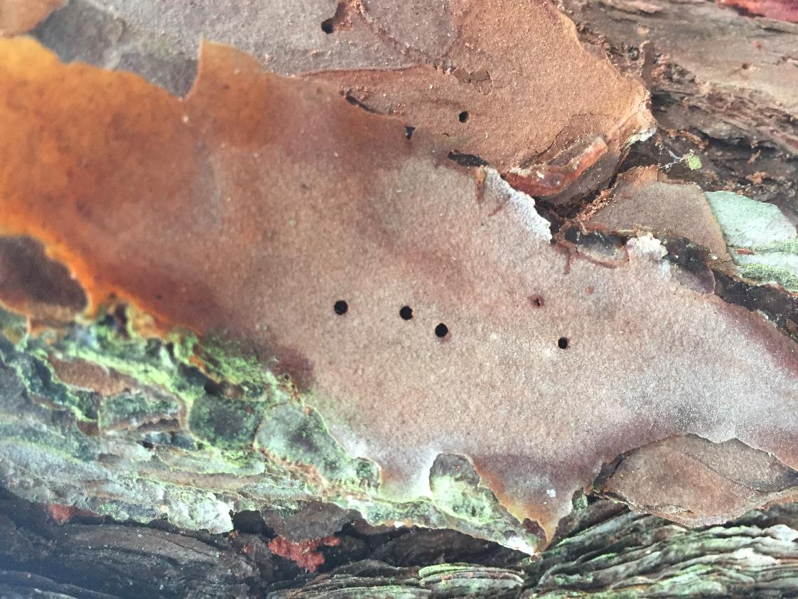
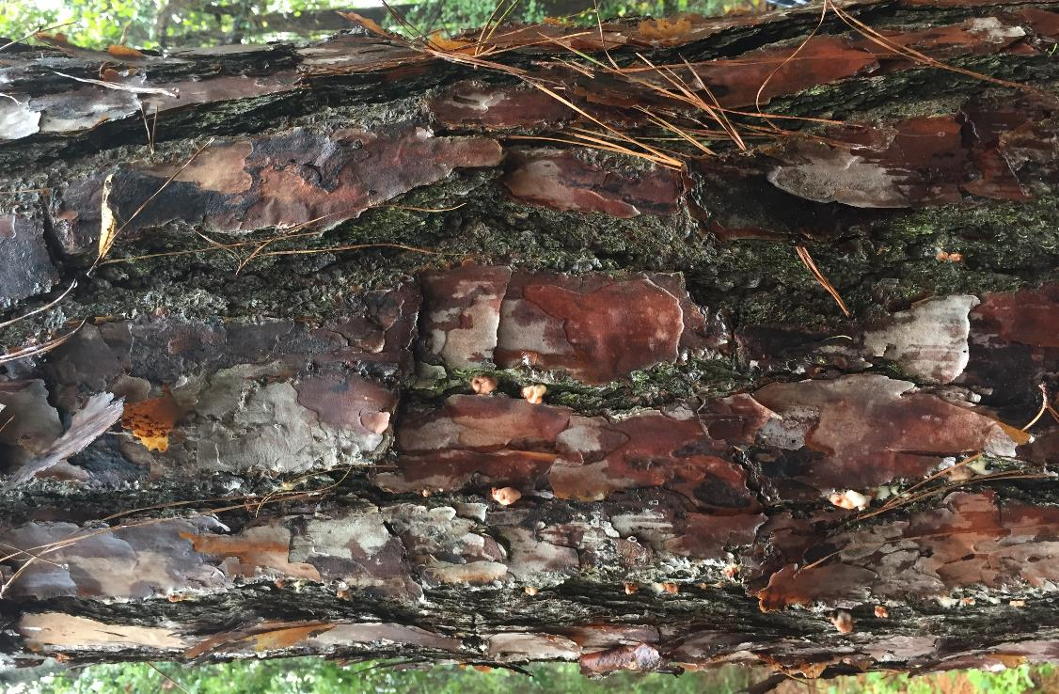
SPB
pitch tubes in bark crevices
engraver beetle
entrance/exit holes on bark plates
Notes:
Comparison of SPB and engraver beetle entrance holes. SPB entrance holes are in the bark crevices. Pitch tube formation is likely if SPB is attacking a healthy tree. Engraver beetle entrance holes tend to be on the bark plates. Pitch tube formation does not always happen, because engraver beetles attack unhealthy pine trees.

Slide 3
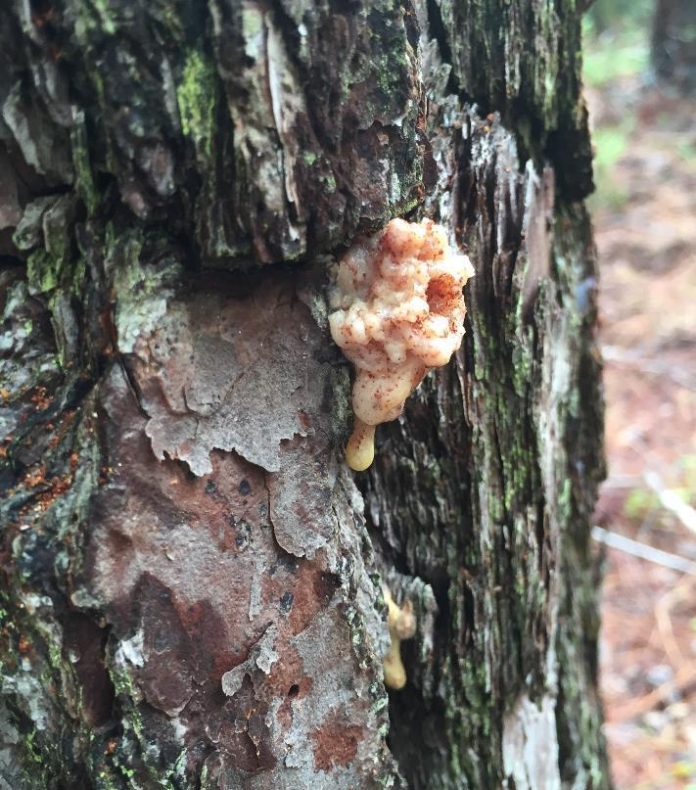
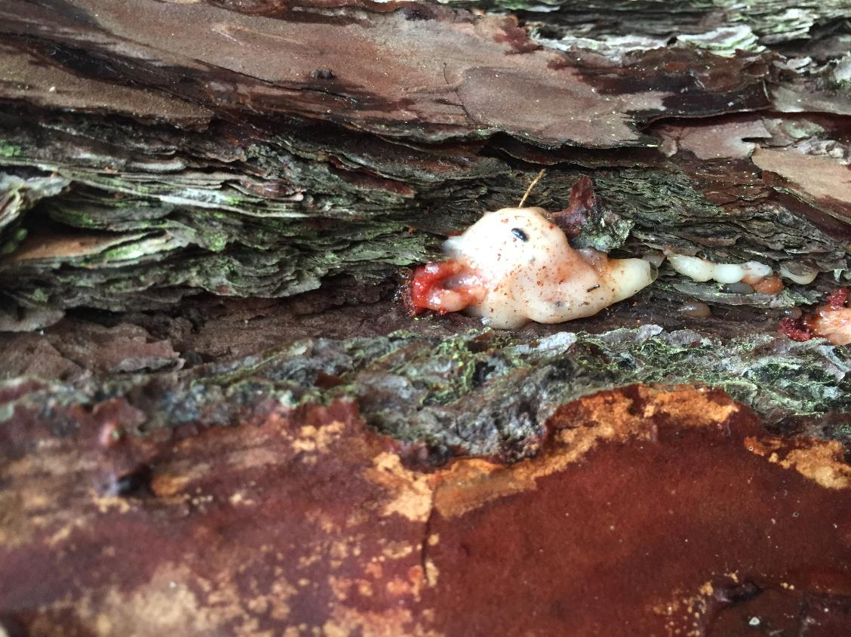
SPB
pitch tubes with sap
black turpentine beetle
large pitch tubes lower on the trunk
Notes:
Comparison of SPB pitch tubes and BTB pitch tubes. BTB pitch tubes are large, sticking out 1 – 1.5 inches. They are located on the lower 12 feet of the pine trunk.

Slide 4
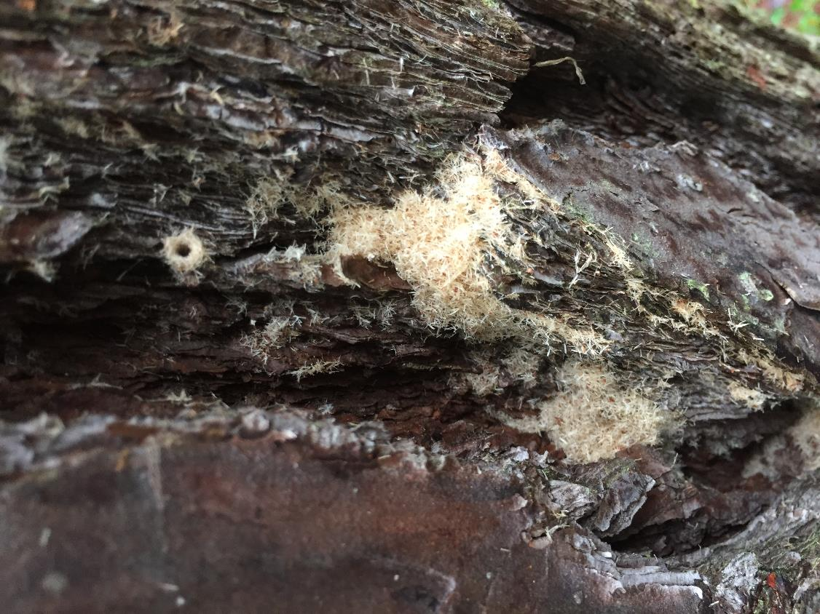
SPB
pitch tubes with sap
ambrosia beetles
entrance holes with “sawdust”
Notes:
When observing SPB damage the pitch tubes will often be apparent. SPB-infested trees may have pebble-like is orangish-pinkish deposits of boring dust. If piles of boring dust, which has the appearance of fine sawdust, are present, that means that ambrosia beetles are present in the tree. The tree is dead or nearly dead.

Slide 5
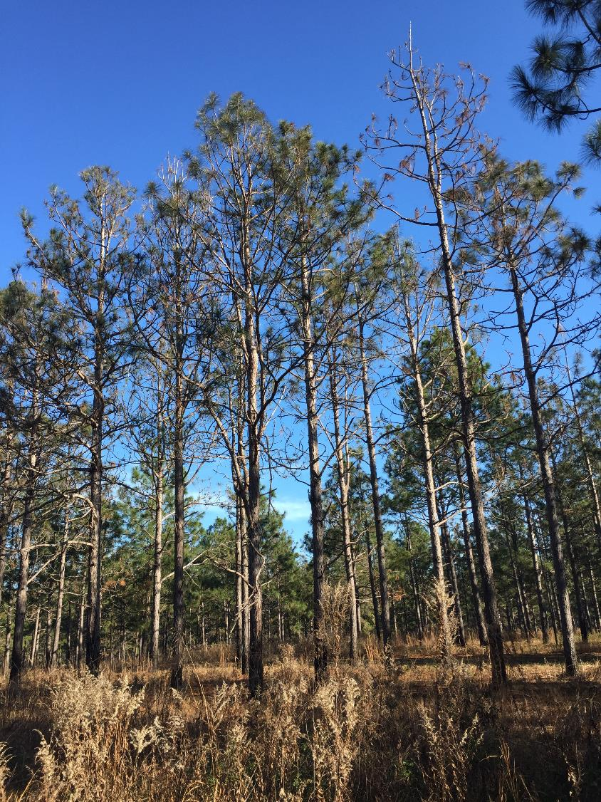
Management Tactics
Systemic insecticide
Contact insecticide
Nothing
Notes:
There are some management tactics that can be used if bark beetles are in a pine tree, but the situations in which insecticides should be used are very limited. For many landowners, once beetles attack a stand there is nothing that would be effective to stop the damage.

Slide 6
Timing is important
Management Tactics
Systemic insecticide
Contact insecticide
Nothing
Preventative measures
Notes:
The most effective thing landowners can do is to take preventative measures to maintain healthy pine stands. Thinning stands and maintaining appropriate weed control are preventative measures, which means that they are effective if used before beetles attack the stand. It is too late once the trees are unhealthy and beetle infested.

Slide 7
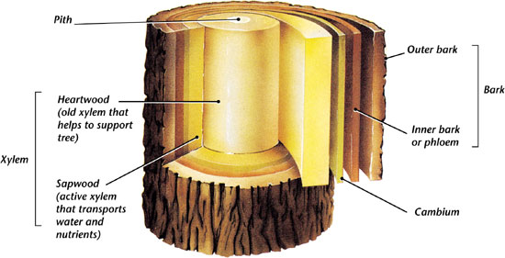
Systemic Insecticide
Tree Structure
Where will systemic insecticides be moving in the tree?
Notes:
Systemic insecticides are applied by soil drench, soil injection or trunk injections. The insecticide is then moved in the xylem to other parts of a tree.

Slide 8
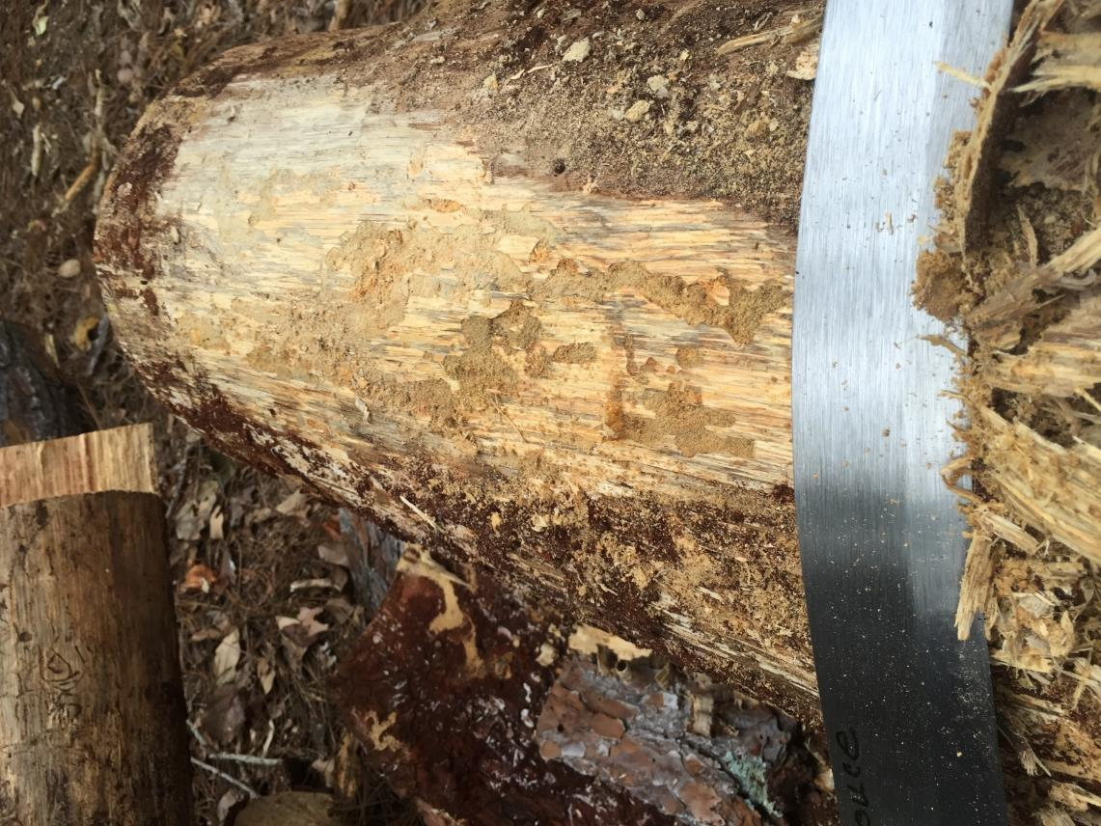
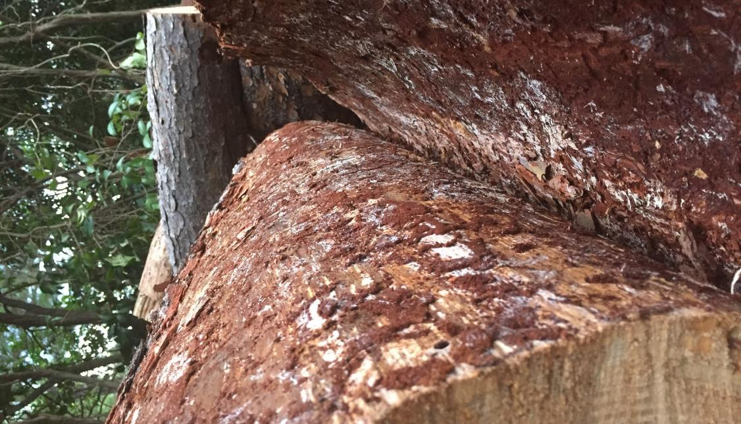
Some systemic insecticides cannot move in the phloem very well
xylem
phloem
systemic insecticide
Notes:
Some insecticides mainly stay in the xylem. Think back to where the bark beetles are feeding: in the phloem. An insecticide cannot kill bark beetles if it does not move into the phloem. So a systemic product that is labeled for use on trees may not be effective against bark beetles if it cannot move into the phloem.
Insecticide use is not appropriate for heavily attacked trees, as these trees are often already dead. Unhealthy trees do not transpire much, and thus, cannot move the systemic insecticides throughout the tree.
Note: If appropriate for the group: Neonicotinoid insecticides like imidacloprid and dinotefuran, although used on some trees, are not effective for bark beetle control. Emamectin benzoate can be effective for bark beetle control, but it is not economical in forest settings. Systemic insecticide use for bark beetles is recommended as a preventative measure to protect high value trees.

Slide 9
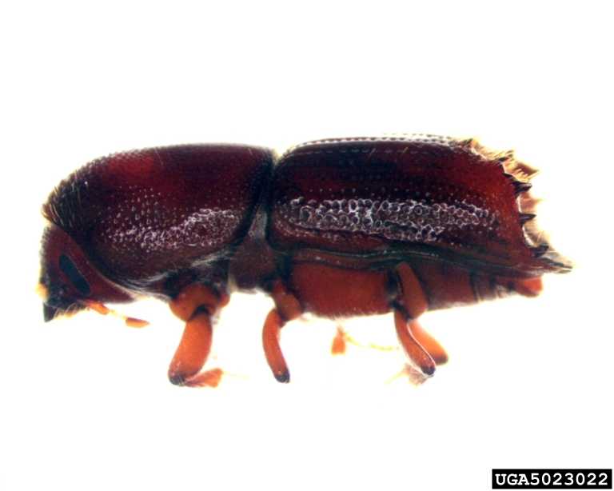
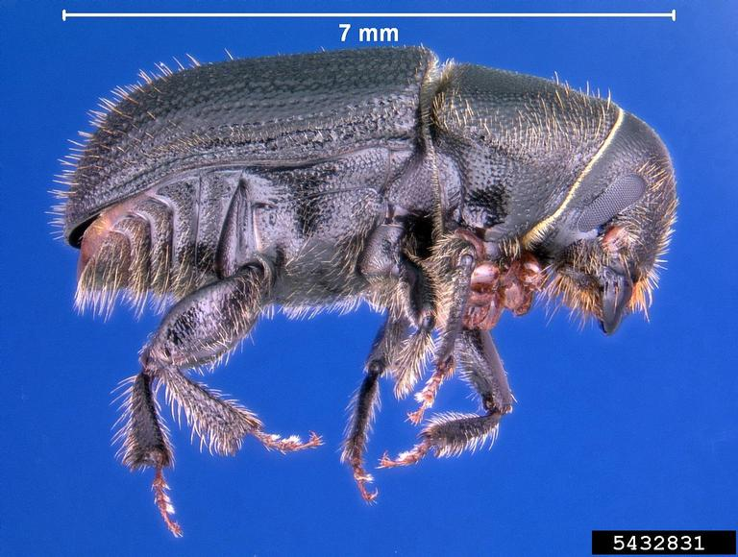
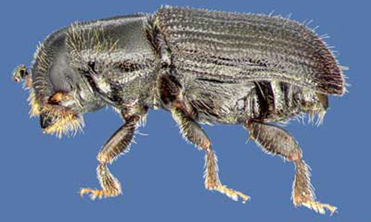
Systemic Insecticides
Not recommended in most situations
Only economical for high value trees
Can be used for BTB and engraver beetles → recommended as a preventative
Not appropriate for SPB
Ips
☑
Pennsylvania Department of Conservation and Natural Resources
BTB
☑
Erich G. Vallery, USDA Forest Service, Bugwood.org
SPB
☒
David T. Almquist, University of Florida
Notes:
Systemic insecticides are not recommended in most bark beetle situations. Any insecticide use for bark beetles is generally not economical in a forest setting. Insecticides are options for protection of high value trees.
Some systemic insecticides can be used as a preventative treatment to protect high value trees from engraver beetles and BTB. Please contact a certified arborist if considering insecticide treatments. The insecticide that has the highest chance of success, emamectin benzoate, must be applied by trunk injection.
Insecticide use is never appropriate for SPB infestations.

Slide 10
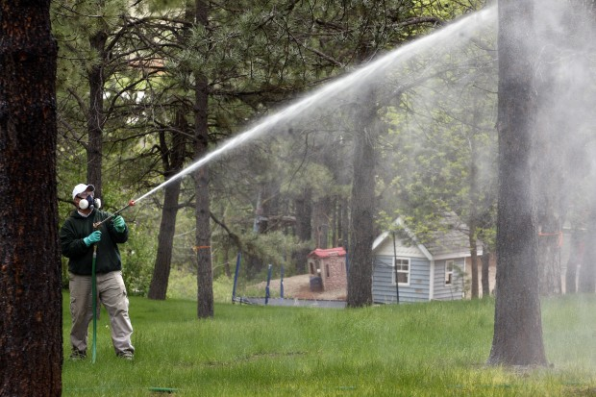
Contact insecticide
contact insecticide
Kevin Woster, Rapid City Journal
Requirements
Numerous product applications each season
High pressure hoses for engraver beetles
Notes:
Some contact insecticides are registered for bark beetle control. Applying contact insecticides involves numerous product applications each season.
Contact insecticides can be appropriate for BTB infestations in high value trees, since BTB only occurs on the bottom 12 feet of the trunk.
Since engraver beetles can attack most locations on a tree, the entire tree trunk must be sprayed with a contact insecticide. This method would only kill beetles entering and exiting the tree, not beetles that are already protected inside the tree. This is not a reasonable option in many urban and suburban settings. In addition, it would not be economical in a forest setting.

Slide 11
Contact insecticide
contact insecticide
Kevin Woster, Rapid City Journal
Possibility of overspray in residential areas
Notes:
Spraying contact insecticides on large sections of tree trunks with high pressure hoses in residential areas has a high risk of non-target impacts. The contact insecticide can kill any beneficial insect it contacts. In addition, many contact insecticides can be toxic to vertebrates (us and our pets). The general public likely does not understand restricted entry intervals, i.e., that they cannot safely go near the area of application for a specified amount of time.
Restricted entry intervals are stated on pesticide labels.

Slide 12
Can bark beetle damage be prevented?
Manage forests for healthy trees.
Notes:
Bark beetle attacks and subsequent damage can be prevented. So there is something that can be done to manage these economically damaging attacks.

Slide 13
Silvicultural methods
Thinned pine stand with open understory
Notes:
Thinning pine stands is necessary to maintain tree health. Pine trees are usually planted close together. Pine canopies produce enough shade to reduce weed growth on the forest floor as the trees get larger. However, the trees will become unhealthy if the stand is not properly thinned.

Slide 14
Unthinned pine stand
Notes:
This is a representation of how an unthinned pine stand may appear. Trees in an unthinned stand become too crowded.

Slide 15
Unthinned pine stand without open understory
Notes:
In addition to properly thinning stands, weed control is important. Weeds can compete with pine trees for resources. More plants have to compete for the same amount of resources in a stand where thinning and weed suppression has not occurred,. Trees will become unhealthy and more susceptible to bark beetle attacks.

Slide 16
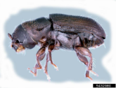
Notes:
Beetles are attracted to chemicals released by unhealthy trees.
Note: SPB is used in the figure as an example. Other bark beetles use pheromones in a similar manner.

Slide 17
pheromone dispersal
Notes:
Beetles release pheromones that draw in more beetles. Since stands are tightly packed with too many trees and weeds, the pheromone plume is not able to dissipate very well.

Slide 18
pheromone dispersal
Notes:
More bark beetles begin infesting and killing pine trees.

Slide 19
Thinned stand
Notes:
However, if the stand is more open two things will occur. First, the trees will be more healthy and less likely to be attacked by bark beetles.

Slide 20
Thin pine stands
pheromone dispersal
in a thinned stand
Notes:
Second, the pheromone plume will disperse more easily in an open setting¹. Should bark beetles begin feeding on a lone unhealthy tree in the stand, the pheromone concentration in the stand can be reduced. The dissipation of pheromones in an open stand will provide less of a “draw” for other beetles.
The best way to prevent bark beetle infestations is to properly thin pine stands.
Note: Some residential neighborhoods are built on former pine plantations. Unthinned stands that are now part of someone’s yard will still become susceptible to bark beetles. Hazard tree removal in residential areas can be very costly for homeowners.
¹Pheromone plume dispersal in relation to pine stand density was determined by experiments using a tracer gas as a surrogate for SPB pheromones.

Slide 21
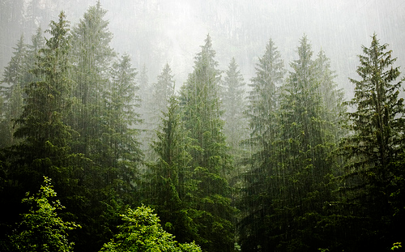
Management Recommendations
Maintain healthy stands
Thin at the proper times
Do not cause additional stress to trees
Avoid soil compaction
Remove slash and damaged trees after a thinning
Be very careful about burning and thinning during a drought
Have a management plan prepared by a registered forester
Monitor your pine stands
The conditions we can change…..
We cannot change the weather.
http://favim.com/image/349848/
Notes:
There are conditions that can be managed. Maintain healthy stands. Thin stands at the proper times, regardless of the market. Do not cause additional stress to trees. Avoid soil compaction, removed slash and damaged trees left after a thinning, and be careful when burning. These are the conditions that we can change.
Get a management plan prepared by a registered forester and follow the plan. Keep an eye on your pine stands to quickly detect problems.
The weather cannot be changed. Climate variations, such as drought, can cause many trees on the landscape to be stressed and unhealthy. Even engraver beetle infestations can become problematic during these conditions.
Manage for healthy stands to reduce the chance of infestation during times that cause landscape-level tree stress.

Slide 22
Georgia Forestry Commission
County Forester
http://www.gfc.state.ga.us/about-us/contact-us/county-units/index.cfm
Notes:
Please contact the Georgia Forestry Commission if you suspect bark beetle infestations in pine stands or yard trees.
Note: GFC county foresters are great forest professionals to partner with ANR agents on forest health issues. Please visit the following website to obtain the contact information for your county forester:
http://www.gfc.state.ga.us/about-us/contact-us/county-units/index.cfm

Slide 23
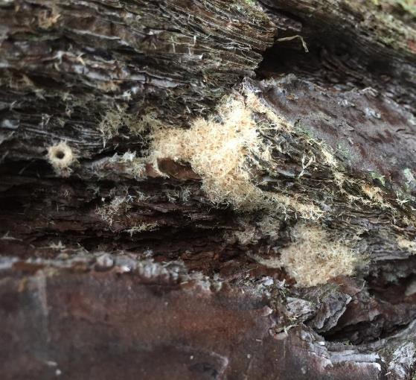
Questions?
WSFNR - 17 – 51
The University of Georgia Warnell School of Forestry and Natural Resources offers educational programs, assistance and materials to all people without regard to race, color, national origin, age, gender or disability
The University of Georgia is committed to principles of equal opportunity and affirmative action.
Notes:
Publication WSFNR-17-51
The University of Georgia Warnell School of Forestry and Natural Resources offers educational programs, assistance and materials to all people without regard to race, color, national origin, age, gender or disability
The University of Georgia is committed to principles of equal opportunity and affirmative action.

