Slide 1
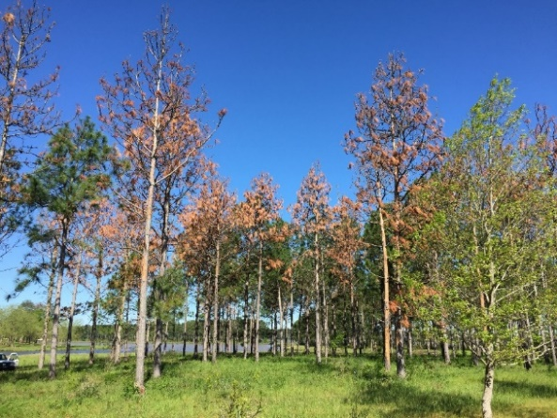
Bark sloughing off
Deodar Weevil
Pissodes nemorensis
Snout weevils (Curculionidae)
1 generation each year
Active fall to early spring
New adults emerge in spring
Attack weakened/dying trees
Secondary
Notes:
Deodar weevils are generally not a common issue in pine forests. However, during the winter/spring 2017 numerous longleaf pine stands in Georgia were affected by deodar weevil. Deodar weevils have one generation a year and are active in the fall to early spring.
Outward symptoms of a deodar weevil infestation are dying crowns and bark sloughing off of the trunk.

Slide 2
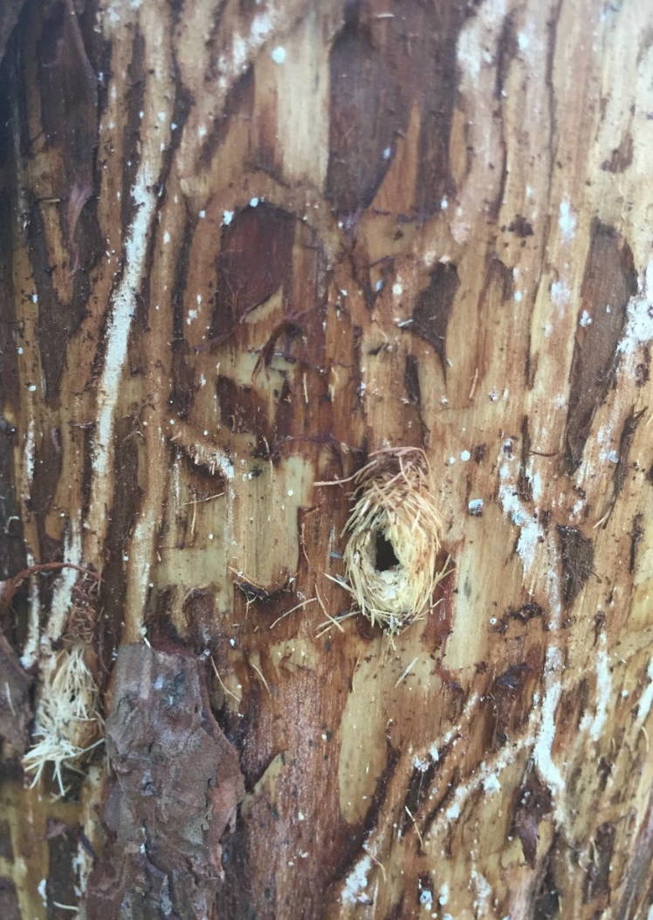
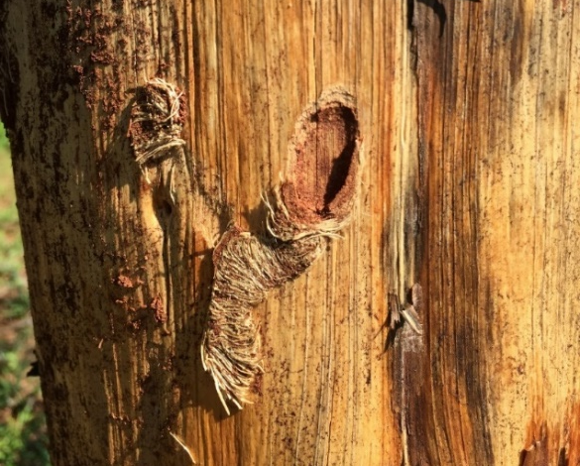
Deodar Weevil
Pissodes nemorensis
Snout weevils (Curculionidae)
1 generation each year
Active in the fall
New adults emerge in spring
Attack weakened/dying trees
Secondary
Chip cocoons
Notes:
Females make tunnels under the bark and lay eggs. When larvae hatch they begin feeding inside the bark. Deodar larvae is one of the tree pests that make chambers surrounded by a “chip cocoon” in which to pupate. Adults emerge in the spring and are inactive during summer.
Deodar weevils are a secondary pest. Control options are not recommended, because the trees are already unhealthy when deodar weevils attack.

Slide 3
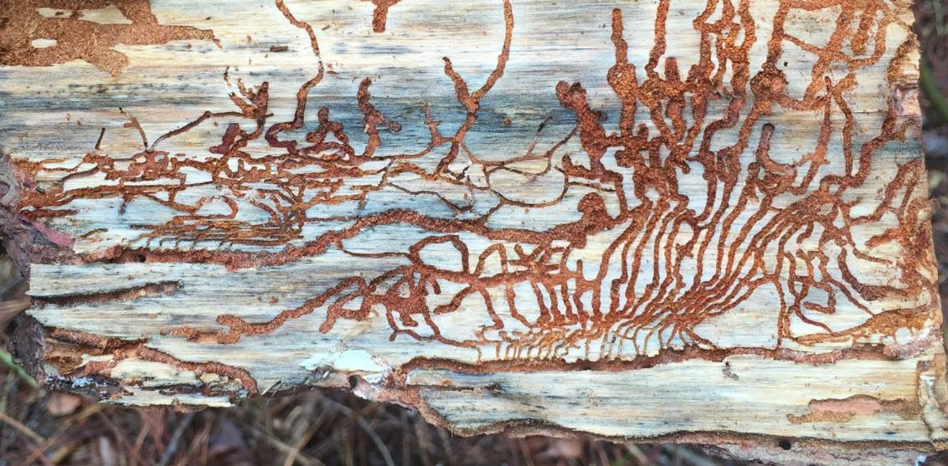
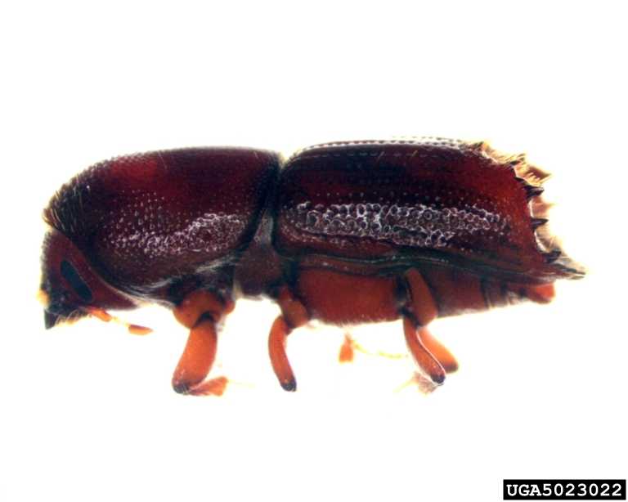
Engraver galleries
Engraver Beetles
Ips avulsus, grandicolis, calligraphus
Isolated occurrence (usually)
Colonize stressed trees, branches, slash
Secondary
Pennsylvania Department of Conservation and Natural Resources
Pennsylvania Department of Conservation and Natural Resources, Bugwood.org
Notes:
Engraver beetles, also called Ips beetles, are a suite of bark beetle species. Engraver beetles have numerous generations each year, and lifecycles as short as 20 days. These are small beetles; less than ¼ inch long. A distinctive feature of engraver beetles is the spines located at the rear of the abdomen.
Males enter the tree and begin digging galleries. Females are drawn to the males by pheromones, which are chemical signals. A male will mate with multiple females, who then begin excavating their own galleries to lay eggs. Each larva that hatches begins digging its own gallery.
Engraver beetles attack stressed trees, damaged branches, and the tree residues left after logging, or slash. Occurrence of engraver beetles is usually isolated, so only a couple of stressed trees in a stand are attacked. However, during unfavorable conditions, such as drought, engraver infestations can affect entire stands.
Note: “Ips”, as in Ips beetle, is pronounced as a word not as an acronym.

Slide 4
Small southern pine engraver
Ips avulsus
Eastern five-spined
Ips grandicollis
Pine engraver
Ips pini
Six-spined Ips
Ips calligraphus
Ips Bark Beetles in the Southeastern U.S.
Southern Regional Extension Forestry
D. Coyle, B. Self, J. Floyd, and J. Riggins
http://www.sref.info/resources/publications/ips-bark-beetles-in-the-southeastern-u.s
Notes:
Ips avulsus → 4-spined engraver usually attacks logging slash and the upper part of a tree (small - medium branches and the upper trunk).
Ips grandicollis → Eastern five-spined Ips usually attacks the middle or upper part of the trunk and logging slash.
Ips pini → Pine engraver attacks logging slash, crowns, and smaller trunks. The Ips pini range extends only into the Appalachian region of Georgia.
Ips calligraphus → Six-spined Ips usually attacks the lower to middle trunk, larger limbs, and logging slash.
Numerous engraver beetle species may attack a tree at the same time. Remember that engraver beetles are secondary. Once an engraver beetle attack is confirmed, it is time to start looking for the primary problem with the pine tree.
Note: Presenting species specific information will be good when taking to foresters, but may not be necessary for urban and suburban audiences.

Slide 5
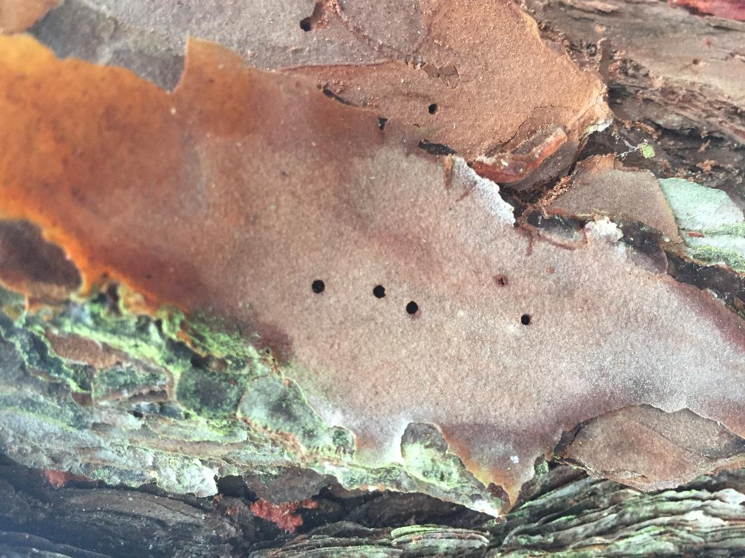
Engraver Beetles
Ips avulsus, grandicolis, calligraphus
Colonize stressed trees, braches, slash
Stressed trees
Isolated occurrence
Engraver galleries
in the inner bark
Engraver exit/entrance holes on the bark plates
Notes:
Engraver beetles bore galleries in the inner bark. Each species’ gallery looks a little different. For example, the gallery above was created by Ips calligraphus (six-spined Ips).
Entrance and exit holes are usually located on the face of the bark plates. Flowing and dried pitch may not be present, because engravers attack unhealthy trees. The trees may not be able to produce the pitch to flush out the beetles.

Slide 6
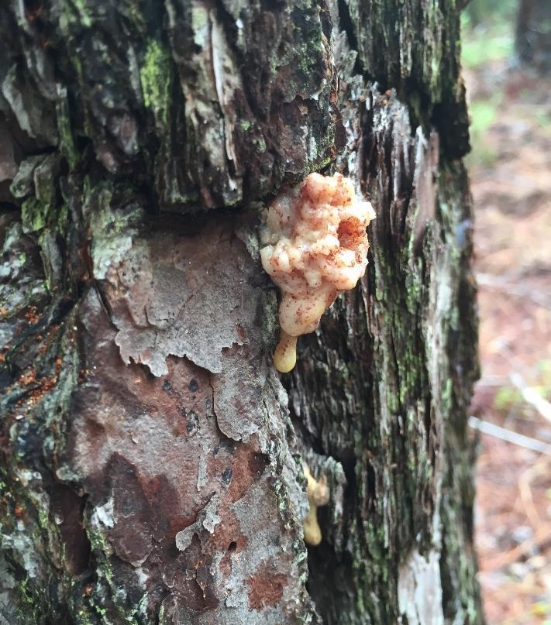
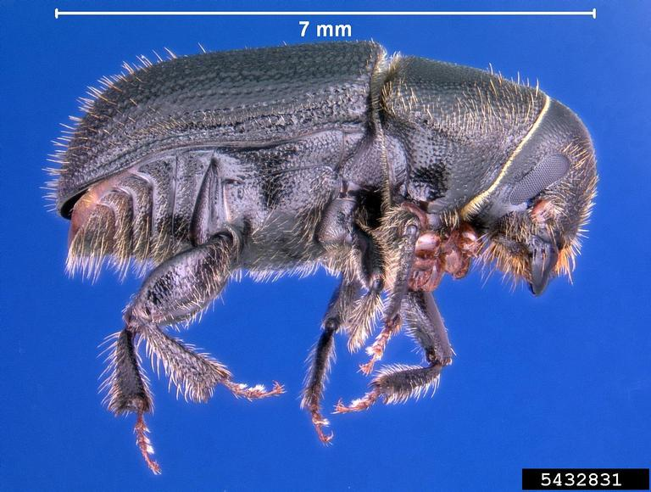
Black turpentine beetles
Dendroctonus tenebrans
Lower 12 feet of the trunk
Scattered/patchy pine mortality
Accumulated attacks over numerous years can kill trees
Feed on injured/stressed trees
BTB pitch tubes lower on the trunk
Erich G. Vallery, USDA Forest Service, Bugwood.org
Notes:
Black turpentine beetle (also known as BTB) is the largest bark beetle species in the southeast US. They are approximately 1/3 inch long. Signs and symptoms include fading (green to yellow to brown) of the needles, reddish-brown boring dust, and large pitch tubes lower on the bole of the tree.
Females infest the tree trunk from the ground to up to 12 feet high. A male joins the female in the tree. Females tunnel a gallery that is 0.4 in wide by 8 – 12 in long. Larvae feed clustered side by side, which is distinctive feature of BTB feeding. In other bark beetle species, each larva bores its own tunnel. All life stages of BTB can be found in the tree together.
Because BTB does not transmit blue stain fungi, has a limited feeding area on the tree, and has a colonial feeding habit, trees are usually not killed. However, attacks over many generations or multiple years may cause pine mortality.
BTB attacks trees that are already unhealthy. They are secondary pests. Because of their limited feeding area on the trunk, some control measures may be successful.

Slide 7
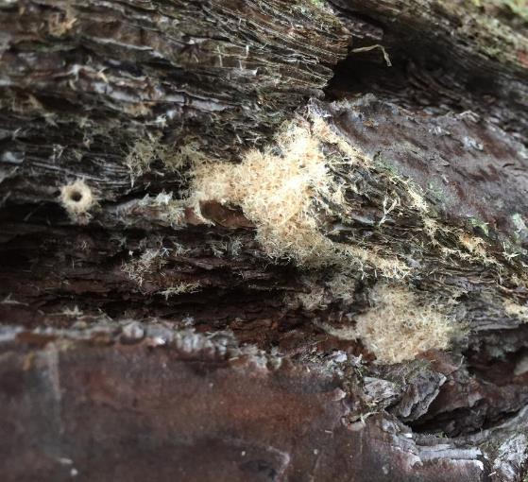
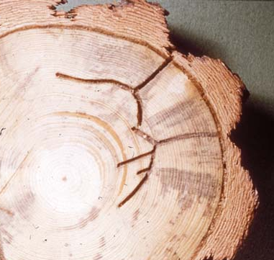
Ambrosia beetles
Xyleborus spp., Xylosandrus sp., Platypus sp.
Small (approx. 2mm)
Usually attack only dead/dying trees
Part of the normal decomposition process
Fungus-feeding beetles
Dig tunnels in trees to grow fungi
Fungi is their main food source
Beetle brings their fungi to the tree
Cannot survive on plant tissues alone
“Sawdust” from entrance hole
Galleries deep into heartwood
Wayne Brewer, Auburn University, Bugwood.org
Notes:
Ambrosia beetles are a suite of species from the insect subfamilies Scolytinae (same family as the bark beetles) and Platypodinae (Subfamilies of Curculionidae). These beetles are very small, less than ¼ inch. Ambrosia beetle activity in trees is part of the normal decomposition process. These small beetles attack dead or dying trees – both hardwood and pine. Different species attack different types of trees. Sign of ambrosia beetle activity include little boring dust tubes sticking out of the trunk and/or piles of boring dust located at the base of a tree. Since trees are dead or dying signs and symptoms of other beetle activity may also be present.
Ambrosia beetles bring fungi with them, often housed in special little pockets on the outside of their bodies. As they dig tunnels in the phloem, sapwood, and heartwood, fungal spores are introduced to the tunnels. The beetles dig their tunnels to provide a location in which the fungi can grow. They then eat the fungi growing in their “garden” inside the pine tree.
Females lay eggs, and once the larvae hatch they begin to dig their own tunnels. The fungi blocks the vascular tissue in the tree and contributes to tree decomposition.
No chemical control is recommended for ambrosia beetles in pine, because the trees are dead or nearly dead at the time of ambrosia beetle colonization. Once ambrosia beetles are present the tree cannot be saved.
Some species ambrosia beetles attack hardwoods, and can be problematic in landscape, nursery, and orchard settings. Often control measures are used to suppress these ambrosia beetles attacking hardwoods. This is not the same case as ambrosia beetles in pines.
*Other bark beetles will product some boring dust, but since the trees are still alive and producing sap, the boring dust will have a darker color and moister consistency. Ambrosia beetle boring dust is light colored and dry because the tree is already dead.

Slide 8
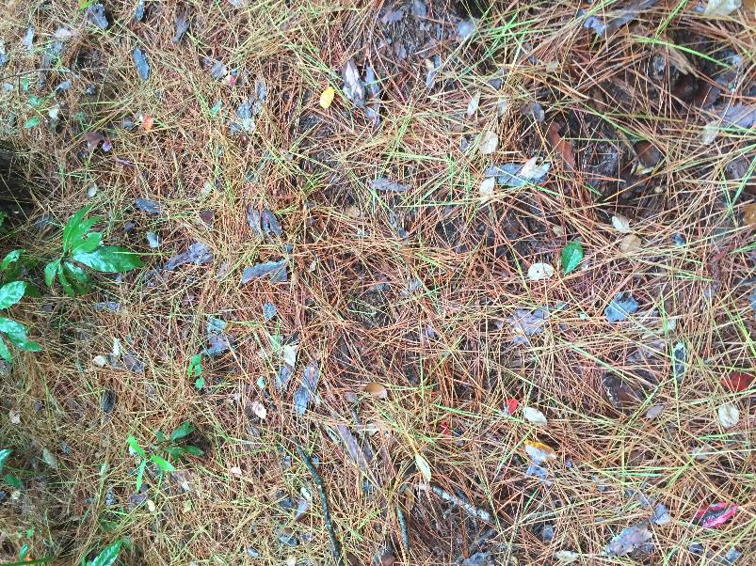
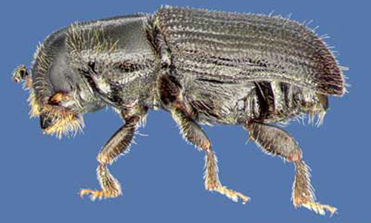
Southern pine beetles
Dendroctonus frontalis
Native pest
Low level attacks to stressed trees
Epidemics – healthy trees attacked
Spots expand up to 50 feet a day
Can infest thousands of acres
Pesticide use is not appropriate
Green needles on the ground
David T. Almquist, University of Florida
Notes:
Southern pine beetle (SPB) are small, less than ¼ inch long bark beetles. They are a native pest that can have large population explosions. The tree death that occurs in a SPB epidemic is similar to the type of damage caused by invasive species. SPB are always present in forests at low population levels feeding on stressed pine trees. However, healthy trees are attacked during a SPB epidemic. When SPB attacks healthy pine trees it is a primary pest because SPB alone is causing the plant health issue.
A SPB “spot” is an area where SPB are killing or have already killed numerous trees. SPB spots start with an origin tree and move across the landscape in a particular direction. The leading edge of a SPB spot is the area with the most recently colonized trees. The leading edge can expand up to fifty feet a day. SPB can infest thousands of acres during an epidemic.
SPB spots can be stopped by cutting all infested trees, as well as a buffer of uninfested trees in front of the leading edge. The buffer strip recommendation can be up to 2.5 times the length of the tallest trees depending on how fast the spot is moving or how long it takes to get logging crew to the site.
It is critical to ensure that the leading edge of the spot is properly marked at the time of cutting; SPB will have moved further the next day. It is best to contact a registered forester and the Georgia Forestry Commission if a SPB infestation is suspected.

Slide 9
First
SPB tree
More trees die as infestation spreads.
Newly infested trees
Notes:
The origin of the infestation may be older, wind damaged, lightning struck, or individual stressed trees.

Slide 10
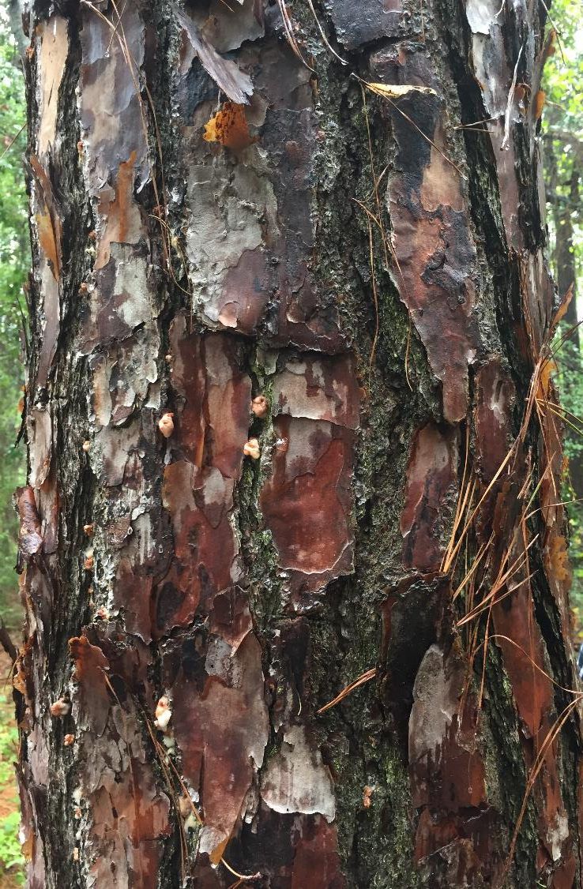
SPB pitch tubes
SPB caught in pitch
Notes:
SPB pitch tubes usually occur in bark crevices. SPB has been flushed out by pitch in the picture on the left. This is what pitch tubes are supposed to do. Sufficient pitch cannot be produced to flush out all beetles when trees are mass attacked by SPB.

Slide 11
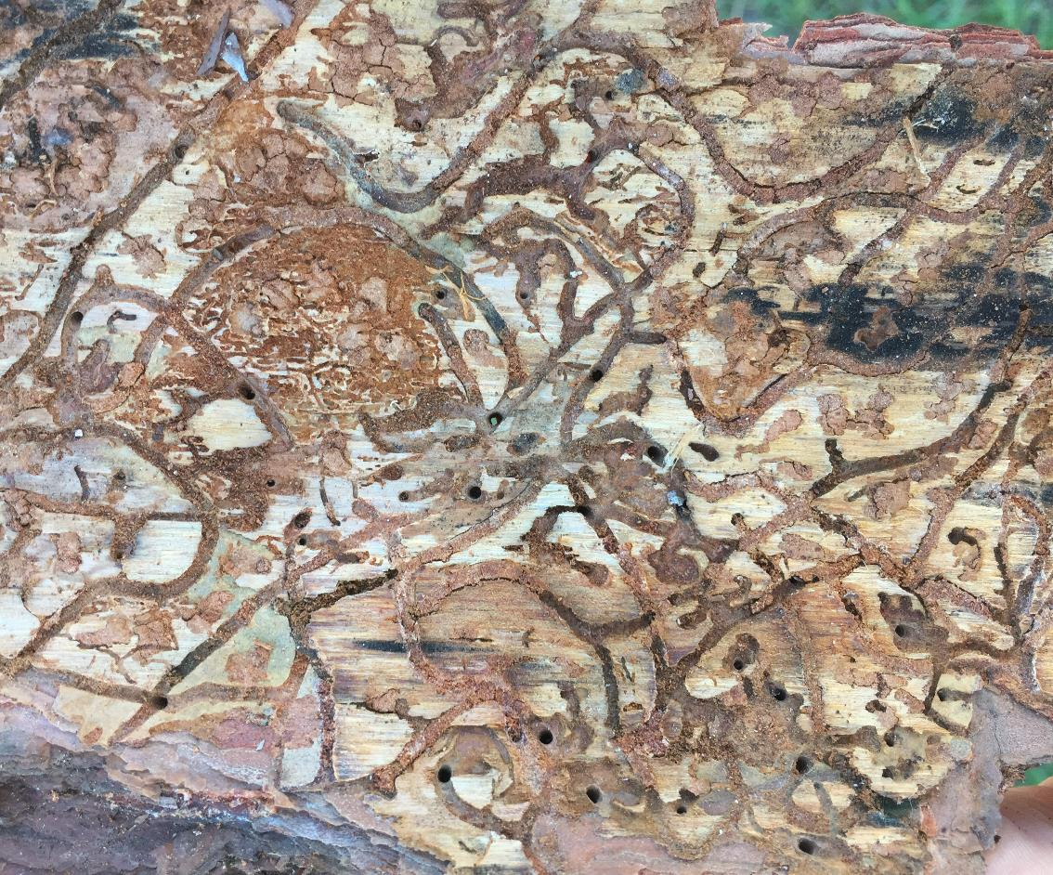
SPB pitch tubes in bark crevices
SPB galleries
Notes:
A SPB female will enter a tree and begin creating a S-shaped gallery. After mating the female lays eggs along the gallery. The male and female can then leave the tree and attack additional trees.
Once eggs hatch each larva begins digging its own tunnel away from the main gallery. Growth from egg to adulthood can take as little as 26 days. SPB can have up to nine generations a year in the south.

Slide 12
orange/red crowns of dead pines
Notes:
Pine crowns will first turn yellow then fade from orange to red during a SPB infestation. Needles will then fall to the ground. Yellow and green needles may be observed on the forest floor when the trees are declining.

