Slide 1
small SPB spot
Notes:
SPB spots start small. The crowns in the picture have an orange appearance.

Slide 2
Larger SPB spots
Notes:
As SPB spots grow they often do so in a particular direction. Note how the spots do not become more round. Spots have a somewhat linear appearance.

Slide 3
Larger SPB spots with multiple heads can appear more roundish
Notes:
However, a SPB spot may have multiple “leading” heads. These spots may have a more roundish appearance.

Slide 4
Different types of bark beetles tend to attack different locations on the tree
Engraver Beetles
Southern Pine Beetle
Black Turpentine Beetle
Notes:
Different types of bark beetles attack different locations on a tree. Engraver beetles can attack from the base to the crown. SPB tend to attack the main bole about four feet off of the ground up to the canopy. BTB attacks from the base to about 12 feet high.
Different beetle damage will be shown in the following slides. Note where on the tree this damage is likely to be observed. SPB damage may not be observed six feet high on the trunk, where it can be easily seen, but it may be occurring further up.

Slide 5
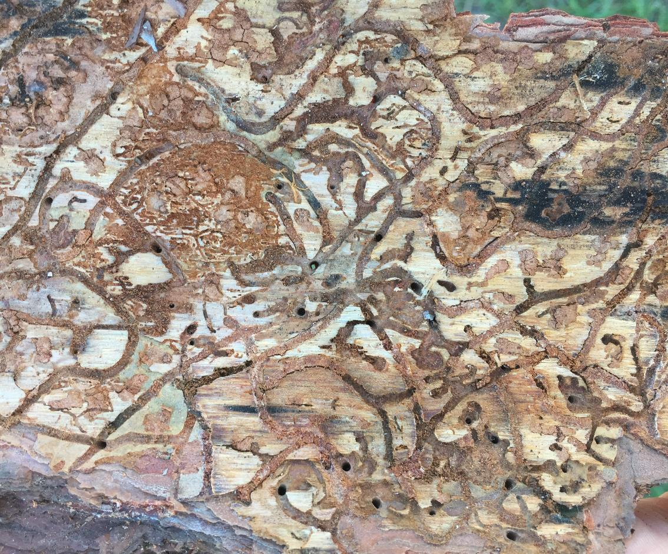
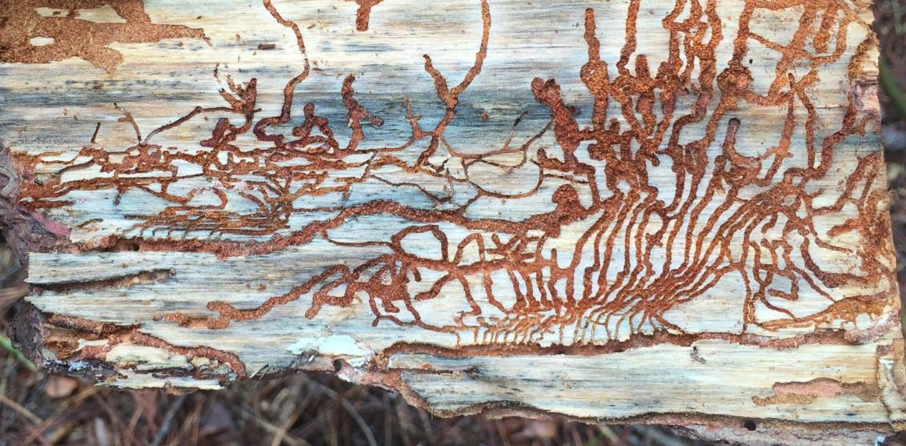
SPB
S-shaped galleries
engraver beetle
branching galleries
Notes:
Comparison of S-shaped SPB galleries to an engraver beetle galleriey. Engraver beetles tend to have H- or Y-shaped galleries. The picture to the left is a SPB gallery. The picture on the right is a six-spined Ips gallery.

